Slide 1

Bike Sharing Predictor
Group 25
Utku Alkan
Ekin Nalbantoğlu
Rebah Özkoç
Alperen Yıldız
Uğurhan Altınbaş
Metin Alperen Balta

Slide 2
Introduction
In certain cities and regions, bike rentals have stayed fairly consistent.
Some days, the rental rates surpass or stay below the average rate.
Rental companies can make improper preparations for certain days because of this deviation.
Predicting these stray days could aid in this problem.
Machine Learning can be utilized for this goal.

Slide 3
Problem Definition
Every day has distinct and differing properties (temperature, weather conditions etc.).
Knowing the rental rates of an incoming day is important to make the necessary preparations.
Wrong predictions could create problems like understaffing, undersupplying, less maintenance etc.
These factors could contribute to minimize profits.

Slide 4
Utilized Datasets
A Bike Sharing Dataset was used that is presented the UCI Machine Learning Repository.
The data set contains information about the rental rates of bikes of the Capital Bikeshare System, Washington D.C., from 2011 to 2012.
The data set also contains a specific day’s properties like temperature, humidity etc.
Data set contains two .csv files, day.csv and hour.csv.
There are no NULL values in the data set.

Slide 5
Methods
Various graphing libraries of Python to show the correlation between data.
Hypothesis tests to confirm which factors affect rental rates (t-tests, ANOVA tests).
Various Machine Learning algorithms to compare and find the best predictions (KNN, linear regression etc.).
Ensemble models to fine-tune and obtain the most accurate predictions.

Slide 6
Data Exploration
Notes:
We have made a huge data exploration but we have only included the most effective columns and goth rid of unnecessary data to show a clear exploration.

Slide 7
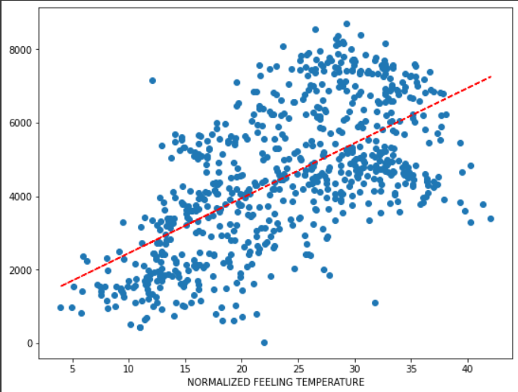
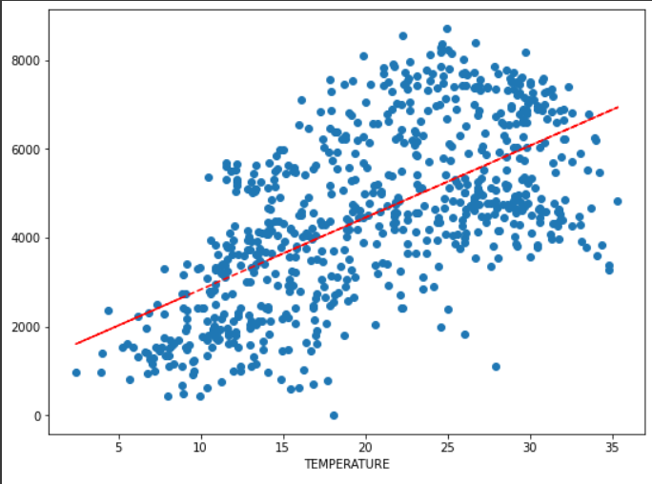
Temperature-Count
Feeling Temperature-Count

Slide 8
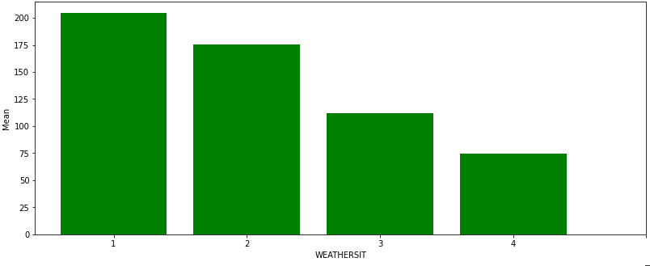
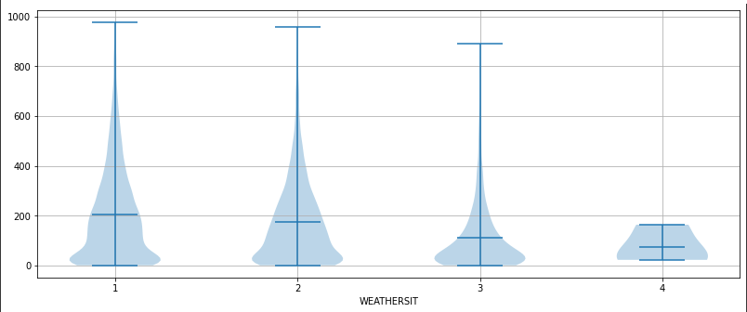
Weather situation
with hour.csv
1: Clear, Few clouds, Partly cloudy, Partly cloudy
2: Mist + Cloudy, Mist + Broken clouds, Mist + Few clouds, Mist
3: Light Snow, Light Rain + Thunderstorm + Scattered clouds, Light Rain + Scattered clouds
4: Heavy Rain + Ice Pellets + Thunderstorm + Mist, Snow + Fog

Slide 9
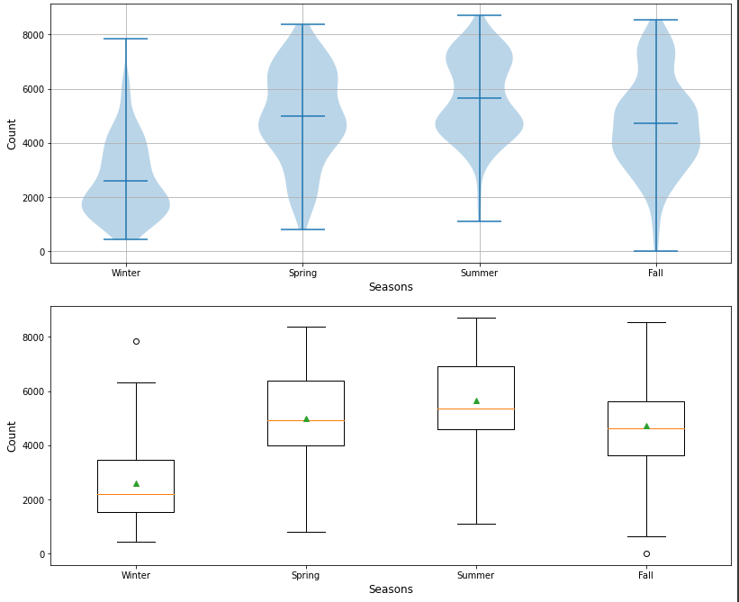
Seasons

Slide 10
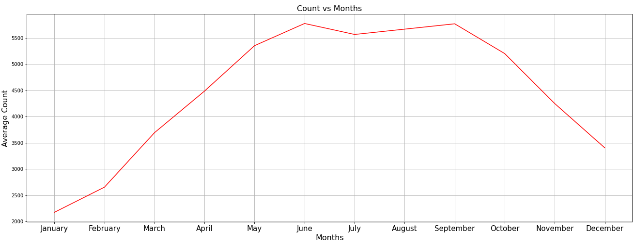
Months

Slide 11
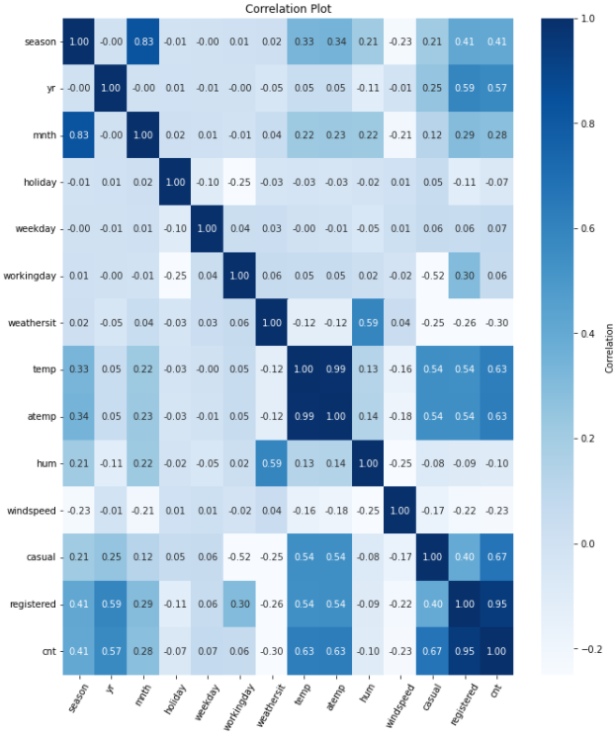
Correlation
Plot

Slide 12
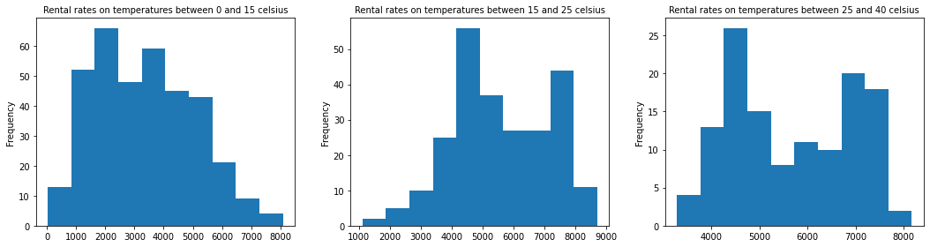

Hypothesis testing
To confirm our hypotheses that some properties of a day affect rental rates.
Utilize t-tests if our factor only has 2 groups to compare.
Utilize Analysis of Variance Tests if our factor has more than 2 groups to compare.
p-value was taken as .05 for our tests.
Notes:
Uğurhan → 6-11 Ekin Utku → 12-13 Uğurhan → Rebah →

Slide 13
Results
Hypothesis tests showed that while almost all factors affect rental rates, some are significant while some are nonsignificant.
Significant factors: Temperature, Feeling Temperature, Wind Speed, Weather Conditions, Seasons.
Nonsignificant factors: Humidity, Holidays, Weekdays, Working Days.

Slide 14

Which Machine Learning Models?
K-nearest Neighbor
Linear Regression
Polynomial Regression
Decision Tree
Random Forest Regressor
Ensemble

Slide 15
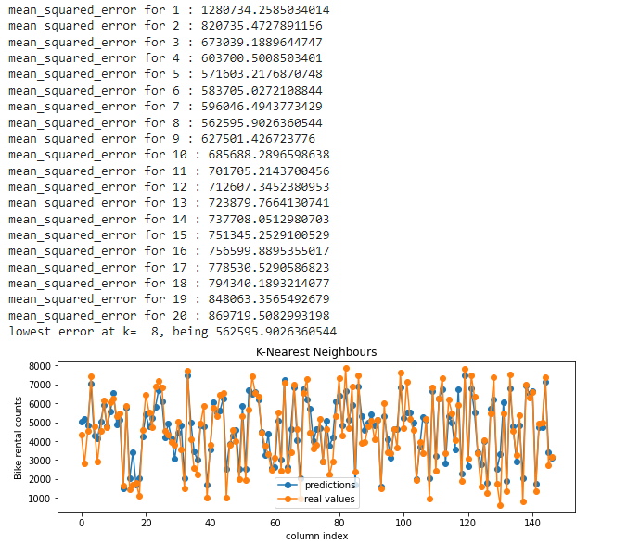
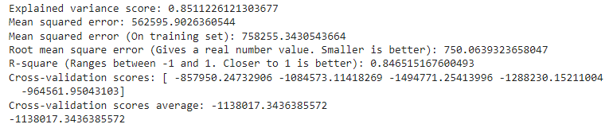
K-nearest Neighbor Model

Slide 16
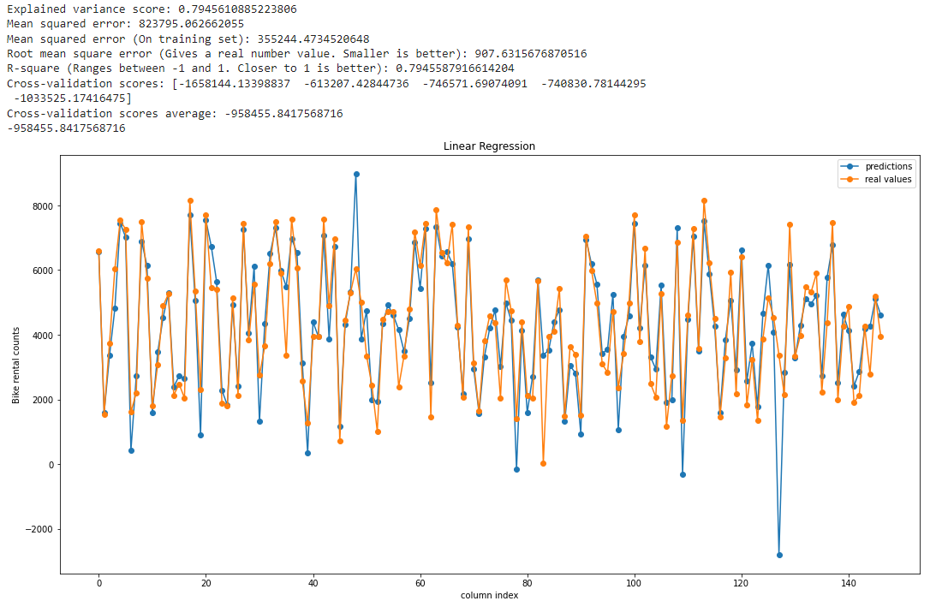
Polynomial regression

Slide 17
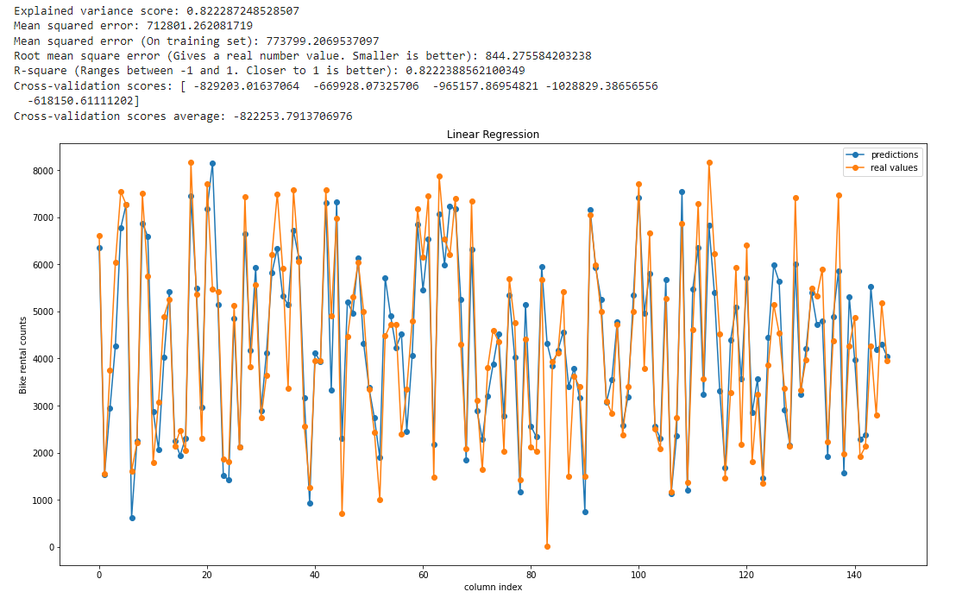
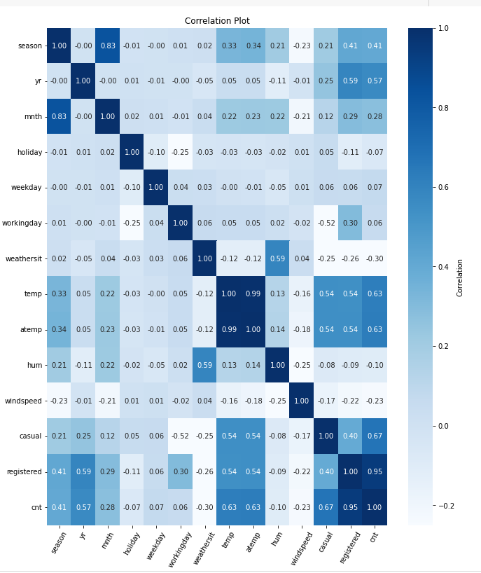
Linear regression

Slide 18
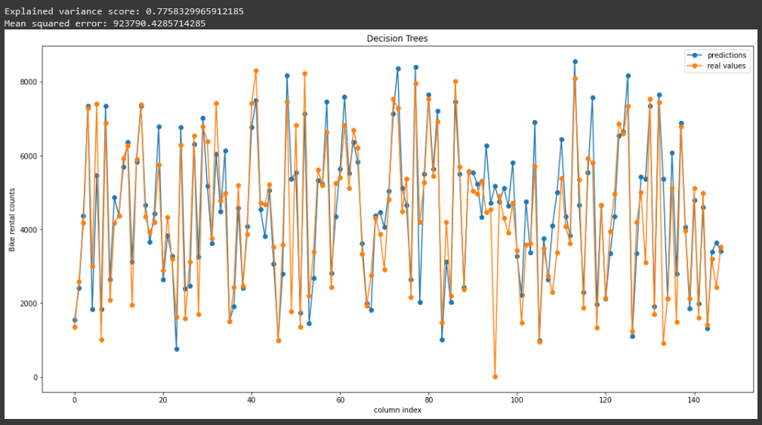
Decision tree

Slide 19
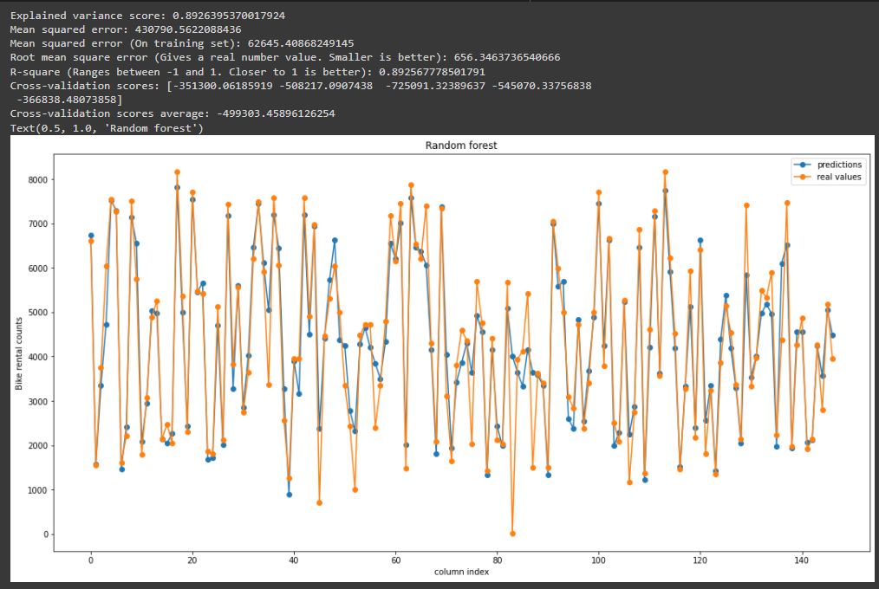
Random Forest Regressor
n_estimators=200, random_state=42, max_features=8

Slide 20
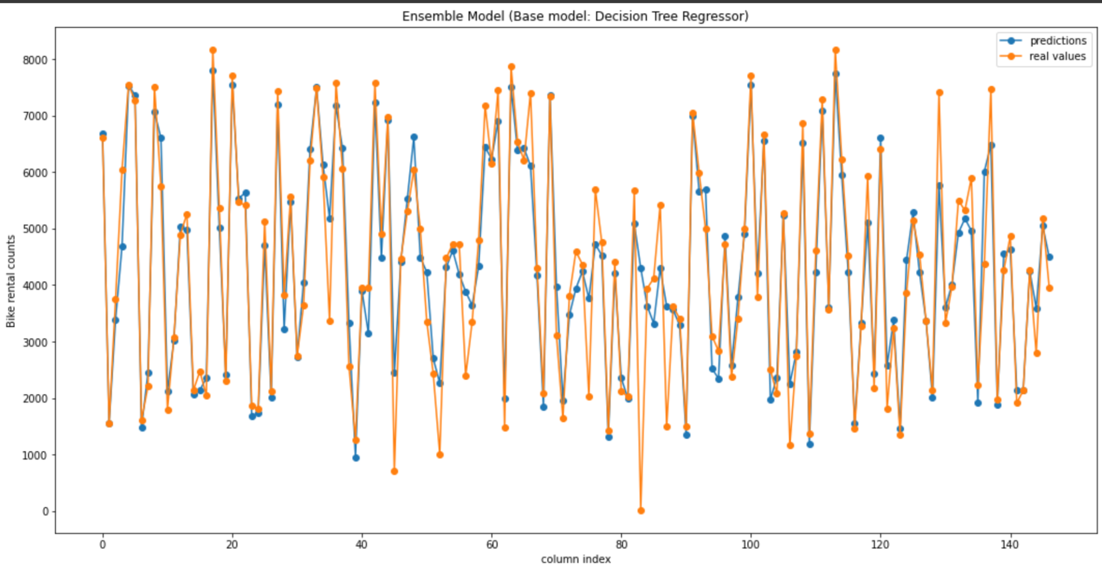
Ensemble

Slide 21
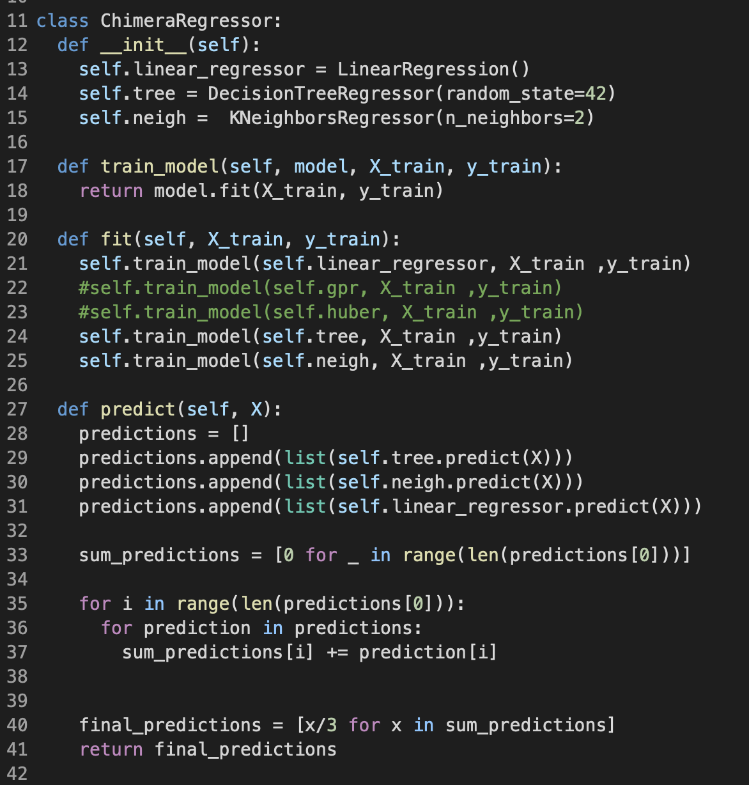
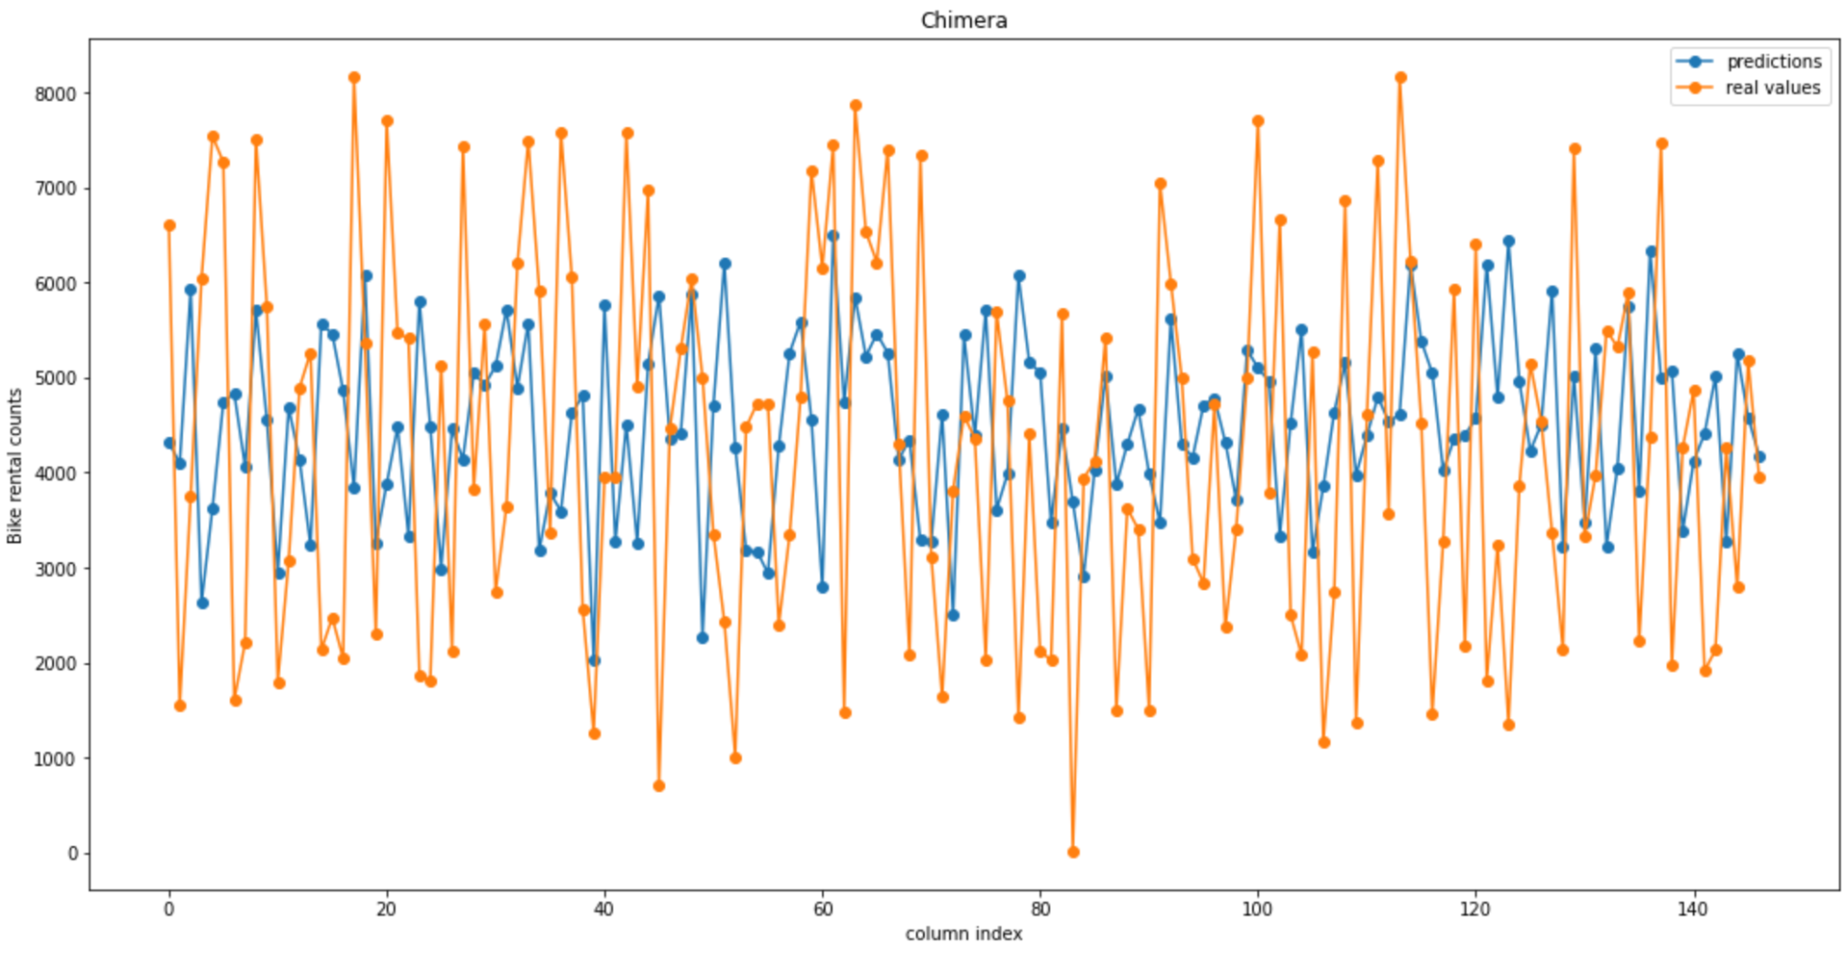
Ensemble

Slide 22
Conclusion
We have established before that having an idea of a specific day’s rental rates would help rental companies to maximize their profits.
By using data from various factors, we have theorized that an algorithm that could predict a day’s rental rates by interpreting these data could be created and utilized for this goal.
We have succeeded in writing a machine learning model by comparing various machine learning algorithms and finally settled on a random forest model after seeing the most accurate results.
By feeding a specific day’s data to our algorithm, it is possible to predict a roughly accurate result of a day’s rental rates as long as we know the properties of that day.
We need to increase our model scores
Collect more data for better model
Trying deep learning models

Slide 23
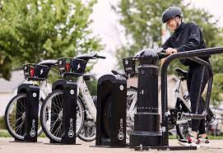

Usage in Real World
Embedding the model in a application
A fully automatic bicycle hiring count estimator
Mobile or web application
Weather forecasting and calendar

Slide 24
How can companies use this information?
Deciding the maintenance days of the bikes
Relocating the bikes to popular regions
Determining the price policy
Providing coupons

Slide 25

Thanks for listening :)
We can answer your questions.

